Slide 1
MINIMALLY INVASIVE & ENDOSCOPIC SPINE SURGERY

Slide 2
Why Minimally Invasive Spine Surgery?
A basic tenet of surgery is to effectively treat pathology with minimal disturbance of normal anatomy: leaving “the smallest footprint.”
-Minimizes tissue trauma, post- operative pain &hospital stay
-Better cosmesis

Slide 3
MISS-Advantages:
Reduced post-operative pain
Tiny scars
Shorter recovery time
Shorter hospital stay

Slide 4
Surgery Tissue damage
Tissue Damage Pain/Function
MIS Less Pain/Better Function

Slide 5
Kawaguchi et al(Spine;1998): Effect of retraction on back muscles in rats
Three comparison groups:
2-hour continuous retraction,
5-minute retraction release after 1 hour of retraction
5-minute release at every 40 minutes of retraction.

Slide 6
Kawaguchi et al(Spine;1998)
Histochemical examination at 48hrs, 1week, 6weeks
Serum CPK MM measurement at 48 hrs
Results: Muscle degeneration max. in group 1
CPKMM highest in group1
Regenerated muscle fibres of smallest diameter in group1

Slide 7
Taylor H et al(Spine;2002): Impact of self retaining retractors on paraspinal muscles
Twenty patients;Intramuscular pressure measurement 5, 30, 60 min. into the surgery
Muscle biopsies before and after retraction studied using ATP birefringence.
Results:
Significant increase in IMP during retraction
Reduced function following retraction(decreased ATP)

Slide 8
Datta G et al(Neursurgery;2004):Back pain & disability after lumbar laminectomy:Is there a relation to muscle retraction?
Twenty patients; continuous monitoring of IMP &IPP
VAS, ODI,SF-36 Health survey
Results:
Rapid/sustained rise in IMP with retraction;IPP→0
VAS,ODI,SF-36 at 6 months worse with retraction>60min;no relation to retractor type, IMP/IPP, surgeon, wound length

Slide 9
MISS circumvents iatrogenic surgical morbidity decreasing tissue injury and blood loss, and thereby reduce length of hospitalization, perioperative pain, analgesic usage, and recovery times.
In many cases, MISS has converted simple decompressive operations into outpatient procedures.
Thus capturing the interest of surgeons and patients alike.

Slide 10
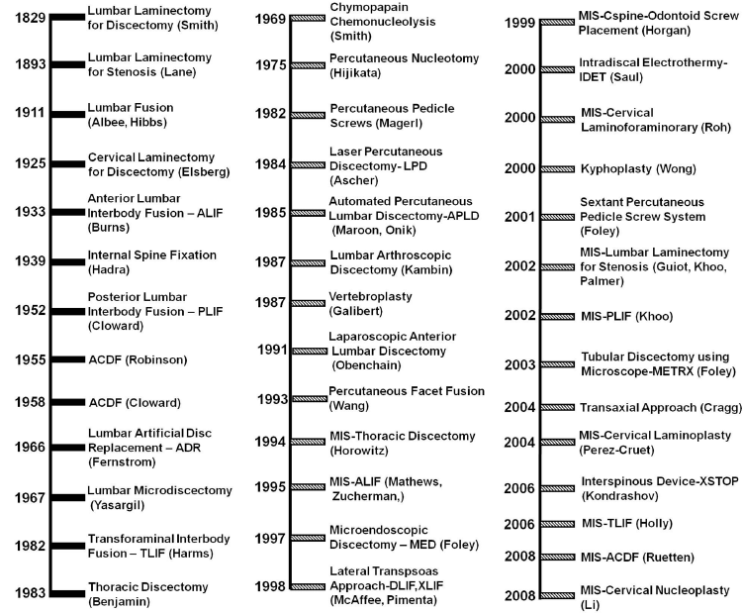
Milestones in Spine Surgery

Slide 11
Types of Spinal Minimally Invasive Procedures
Minimally invasive procedures and technologies can be broadly characterized as:
Traditional open procedures through small incisions(open microdiscectomy),
Endoscopy (thoracic/lumbar discectomy, deformity management, and trauma management),
Tubular retractor–muscle dilation (MED, METRx, XLIF, Sextant, Mantis, and Longitude),
Fine needle procedures (chemonucleolysis, nucleotome procedures, vertebroplasty, and kyphoplasty), and
miscellaneous technologies (laser-assisted percutaneous discectomy, X-STOP, and AxiaLIF).

Slide 12
Keys to MISS
Smaller incisions
Muscle splitting instead of muscle cutting Spine Surgery
Flouroscopic and image-guided navigation

Slide 13
MISS-Lumbar Spine Disease
MI Discectomy
Anterior Lumbar Interbody Fusion (ALIF)
Posterior Lumbar Interbody Fusion (PLIF)
Transforaminal Lumbar Interbody Fusion
eXtreme Lateral Interbody Fusion
AxialIF for Degenerative L4-S1 Disc Disease
Kyphoplasty/Vertebroplasty

Slide 14
Retractor Systems
METRx
MIRA
AccuVision Minimally Invasive spine System
NAPA Minimally Invasive Retractor System
Serengeti Retractor System
Luxor Minimally Invasive Retractor System

Slide 15
Microlumbar discectomy
Entry point is through the interlaminar window
Microscope provides better visualization

Slide 16
Microlumbar discectomy
Indications:
Single level disc herniation
Adjacent bisegmental herniation
Dessicated disc with bony root entrapment/lateral canal stenosis
Contraidications:
Spinal canal stenosis
> 2 level disc
Bony bridging of interlaminar space

Slide 17
Microendoscopic discectomy
First developed in 1997
Muscle splitting approach with serial tubular dilators
Tubular retractor and special endoscope used to perform discectomy

Slide 18
MED-Advantages
It reduces tissue trauma, less traumatic than standard microdiscectomy
Integral visualization and illumination of the operative field through the endoscope
Allows direct visualization of the nerve root and disc disease, and
Enables bony decompression.

Slide 19
MED-Limitations
There is a learning curve to using the system efficiently and safely
Complications like dural tear, if occur can be difficult to repair
Delicate instruments with risk of instrument failure

Slide 20
MED vs Open Lumbar discectomy
Righesso O et al(Neurosurgery;2007)
Randomized controlled trial
40 patients with sciatica/lumbar disc disease;24 months follow-up
Statistically significant variables amongst many studied:
Length of incision- Greater in OD
Length of hospital stay- Greater in OD
Operative time- Greater in MED

Slide 21
MISS-Degenerative Disease of Spine
Advances in imaging, instrumentation, bone graft substitutes have allowed development of MISS
Much of the developmental trends in MISS and in spine surgery in general have been driven by the challenge of achieving arthrodesis in the lumbar spine.

Slide 22
MISS-Degenerative Disease of Spine
The chronology of open techniques for accessing the disc space
1933: Burns-ALIF
1952: Cloward-PLIF
1966:Fernstrom ADR
1982: Harms & Rolinger-TLIF
1991: Obenchain- Anterior laparoscopic disc removal
2002:Khoo- First MIS–PLIF procedure
2006,:Holly and Schwender MISTLIFs using tubular retractors.
2008:Park & Foley- Percutaneous reduction screws (CD Horizon Sextant, Medtronic, Inc.) along with PEEK interbody spacers to perform MISTLIF procedure in patients with Grades I and II isthmic spondylolisthesis.

Slide 23
Minimally Invasive Percutaneous Posterior Lumbar Interbody Fusion

Slide 24
Sextant System
Sextant- An instrument used to measure the altitude of an object above horizon
The scale has a length of 1/6 of a full circle
Principle: Any two points in proximity can be considered part of a circle

Slide 25
Anterior Lumbar Interbody Fusion
Iatrogenic trauma- the main contributior to complications and morbidity associated with open anterior approach to the lumbar spine and lumbosacral junction
The application of microsurgical principles and philosophy could overcome these technique-associated disadvantages.

Slide 26
Anterior Lumbar Interbody Fusion
Retroperitoneal microsurgical appproach
(L2-3,L3-4,L4-5)

Slide 27
Anterior Lumbar Interbody Fusion
Midline microsurgical approach to L5-S1

Slide 28
Anterior Lumbar Interbody Fusion
Voss S et al (1998):
20% reduction in operative time
50% reduction in blood loss
No significant difference in clinical outcome &complication rates

Slide 29
eXtreme Lateral Interbody Fusion-XLIF
Retroperitoneal approach
Lateral flank incision
Microscope/Endoscope

Slide 30
eXtreme Lateral Interbody Fusion-XLIF
Patient starts walking within few hours
Discharged after 24 hours
Rapid return to normal activity, within weeks rather than months

Slide 31
eXtreme Lateral Interbody Fusion-XLIF
XLIF can be performed for a variety of conditions :
Degenerative disc disease,
Recurrent disc herniation,
Spondylolisthesis,
Pseudoarthrosis, osteomyelitis/discitis, and post-laminectomy syndrome.
Anterior and lateral tumors of the thoracolumbar spine
Debilitating spinal deformity (scoliosis).

Slide 32
eXtreme Lateral Interbody Fusion-XLIF
Patient selection is important –
Severe canal stenosis secondary to facet hypertrophy &
Dorsal compressive disease require posterior approach

Slide 33
AxiaLIF
Developed by Cragg,2004
Safe, reproducible, pre-sacral approach
Minimally invasive access

Slide 34
AxiaLIF
Soft-tissue sparing
Annulus remains intact
Restoration of disc height
Immediate rigid segmental fixation and stability of L4-S1
Virgin corridor for a previously operated segment
Enables fusion of L5-S1 without removing implants from rostral previously implanted segment

Slide 35
AxiaLIF-Complications
Hemorrhage
Bowel Perforation
Infection
Hardware failure

Slide 36
Vertebroplasty/Kyphoplasty
Percutaneous vertebroplasty –Deramond et al(1987)
An image-guided, minimally invasive, non-surgical therapy used to strengthen a broken vertebra
Indications:
- Pain caused by osteoporotic compression fractures.
- Pain caused by fractures due to vascular malformations.
- Pain caused by fractures due to tumors, which have invaded the vertebral body

Slide 37
Vertebroplasty/Kyphoplasty
Contraindications:
Recent systemic/spinal infection
Uncorrected bleeding diathesis
Insufficient cardiopulmonary health
Fracture related canal compromise with myelopathy/radiculopathy

Slide 38
Vertebroplasty-Complications
Incidence :< 10%
Increased pain,
Radiculopathies,
Cord compression,
Infection,
Rib fracture,
Adjacent level vertebral body collapse, Venous embolism
Cement migration(radiculopathy-4%;cord compression-0.5%)

Slide 39
Vertebroplasty-Complications
Cement migration can be prevented by parrtial filling of VB(<30% by vol of VB)
Liebschner et al(Spine;2001)-Only 15% volume fraction is needed to restore stiffness to predamaged levels.

Slide 40
Video Assisted Thoracoscopic Surgery
Indications:
-Disc herniation
-Sympathectomy
-Vertebral biopsy
-Vertebrectomy
-Bone graft/instrumentation
-Anterior release for spinal deformity correction

Slide 41
VATS-Surgical approach
Side selection:
Lateralization of pathology
Eccentric placement of aorta
Anaesthesia:
Single lung ventilation/bronchial blockers

Slide 42
VATS-Surgical approach
Position:Lateral decubitus
Port placement:
Reverse L pattern
10mm(3-18mm);3-4 portals First port-Anterior axillary line 6th/7th ICS.
One port caudal & another rostral central to the area of interest

Slide 43
VATS-Thoracic Discectomy
VATS vs Open Thoracotomy
Lanreneau et al(1993): Less pain, improved pulmmonary function & superior shoulder girdle function inVATS group.
Caputy et al (1995):Successful use of VATS for thoracic discectomy in cadaveric/porcine followed by clinical use.

Slide 44
VATS-Thoracic Discectomy
Thoracoscopy Vs Costotransversectomy (CT)&Open thoracotomy for thoracic discectomy
Rosenthal & Dickman(1999):
Fresh neurological deficits- None in thoracoscopy & thoracotomy group;7% in CT group
Intercostal neuralgia-Thoracoscopy-16%;CT-20%;Thoracotomy -50%

Slide 45
VATS-Thoracic Discectomy
One hour reduction in operative time
50% reduction in blood loss,narcotic use & hospital length of stay
Neurological improvement-27/36(myelopathy);19/19(radiculopathy)
Neurological stabilization in all

